Slide 1
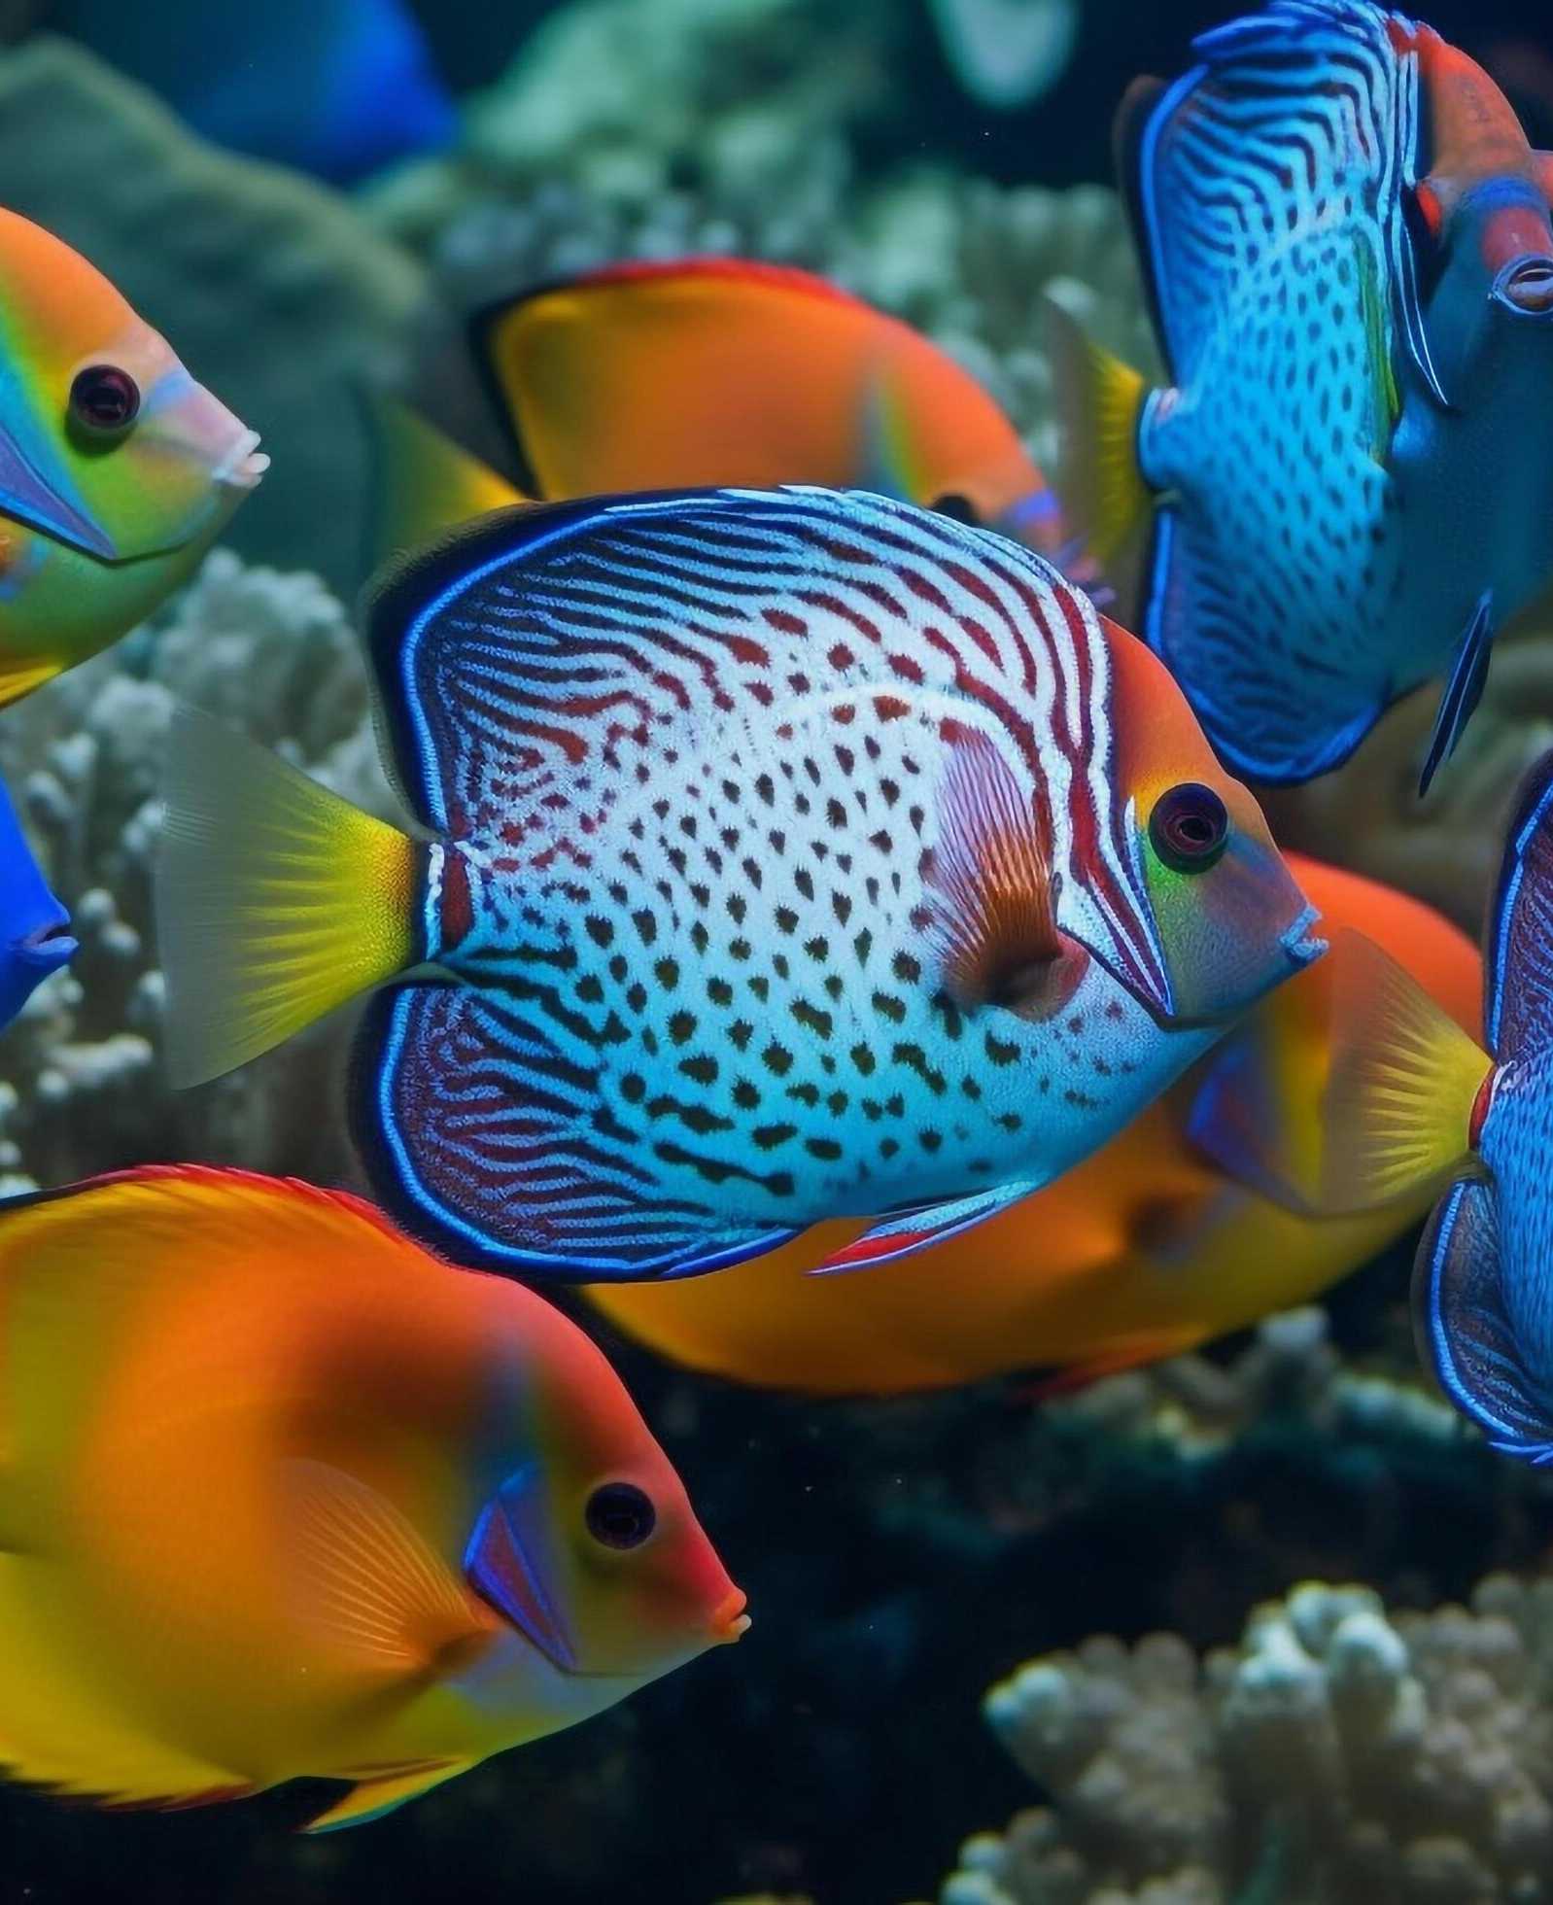
SOCIAL Psychology
Chapter 12

Slide 2
Agenda
What is Social Psychology?
People as Individuals
People in Groups
Group Behavior

Slide 3

What do you think a social psychologist studies?

Slide 4
What determines our behavior?
Situationism
dispositionism
External factors
What might be an external factor that would impact behavior?
Internal factors
What might be an internal factor that would impact behavior?

Slide 5
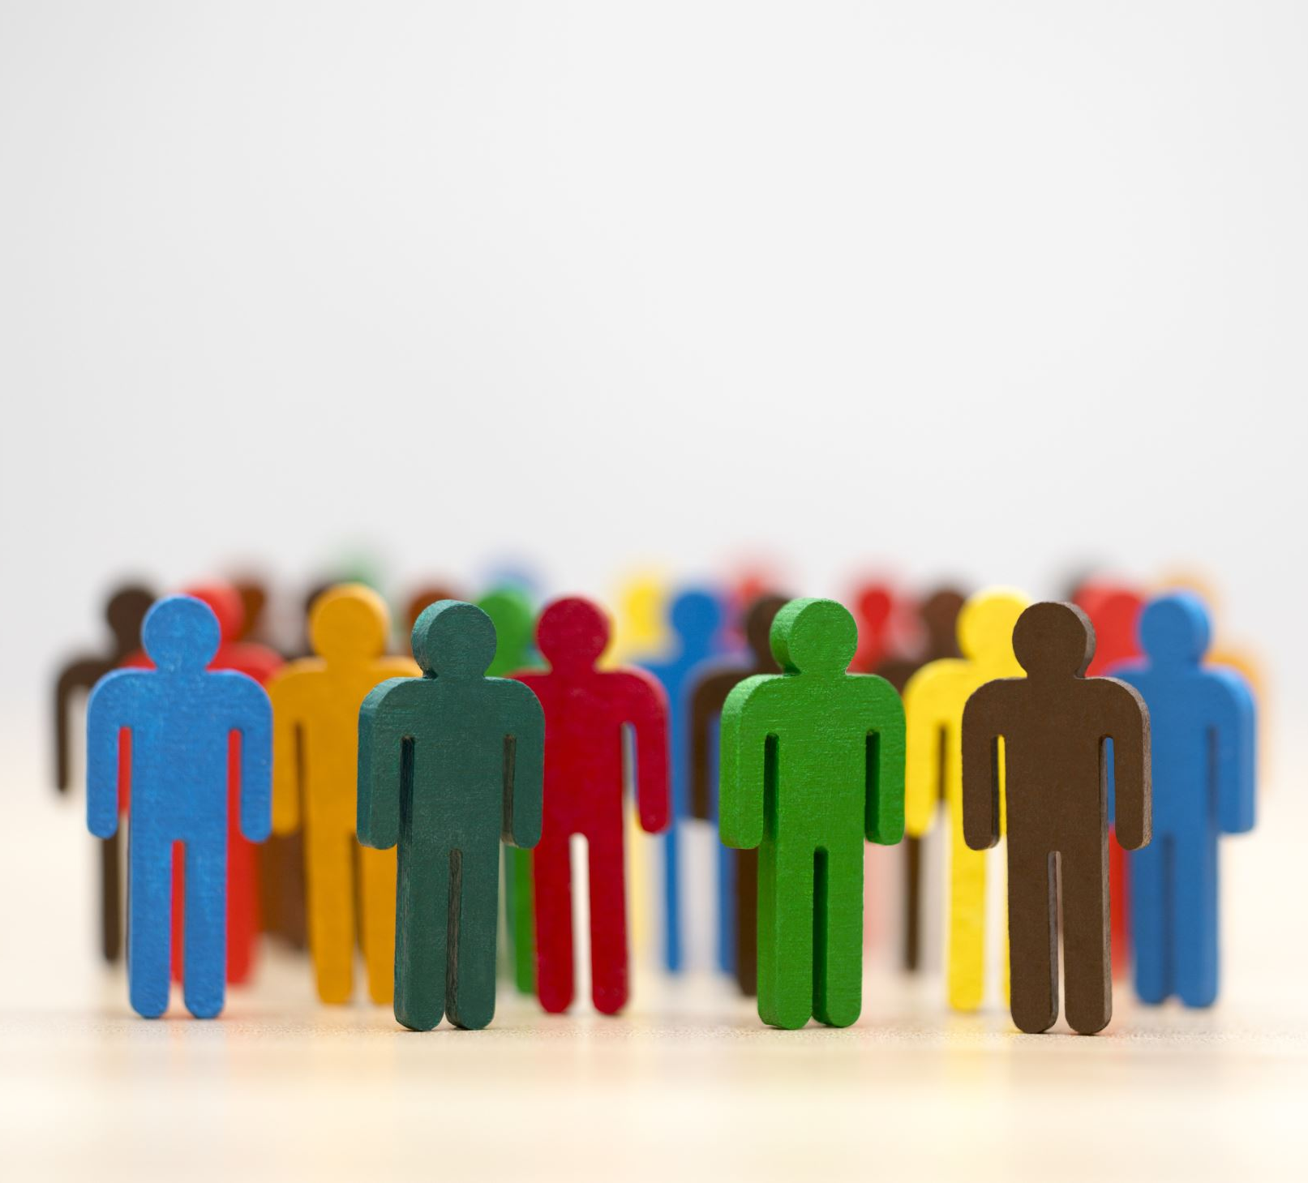
Interpreting Behavior
Attribution
Individualistic vs collectivistic culture
Fundamental attribution error
Actor-observer bias
Self-service bias
Just-world hypothesis

Slide 6
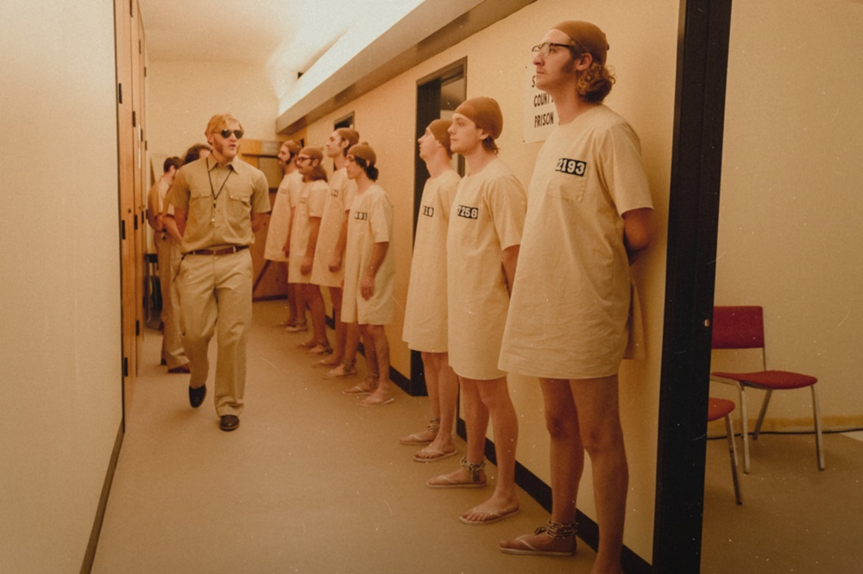
What’s the difference between a social role and a social norm?
Example: The Stanford Prison Experiment

Slide 7
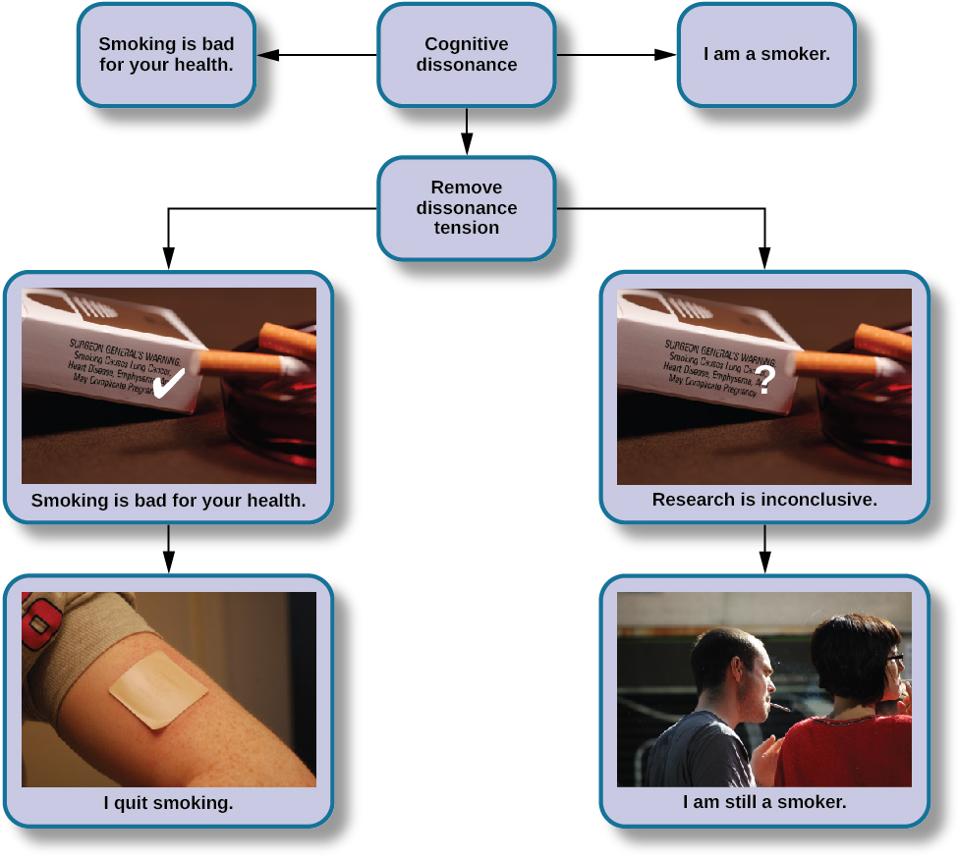
Cognitive Dissonance
Suppose an older brother is severely punished for teasing their younger brother. How might cognitive dissonance impact how the older brother will act towards the younger brother after the parents leave the room?

Slide 8
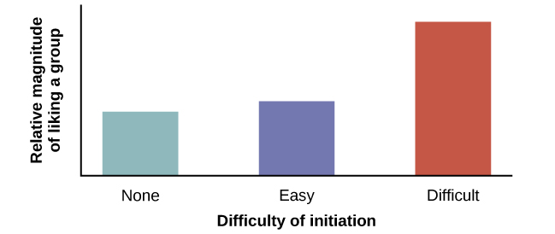
Justification of Effort
What are some real-life examples of where being included in a difficult group could impact someone’s behavior?

Slide 9
Persuasion
Foot-in-the-Door Technique
Elaboration Likelihood Model
Yale Attitude Change Approach

Slide 10
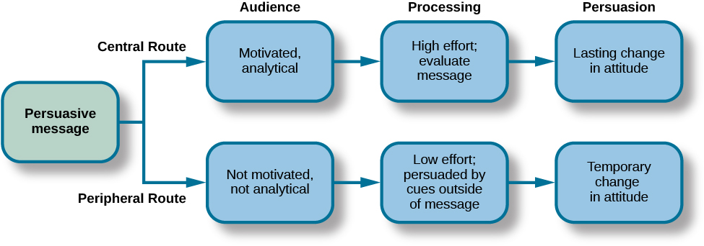
Elaboration Likelihood Model

Slide 11
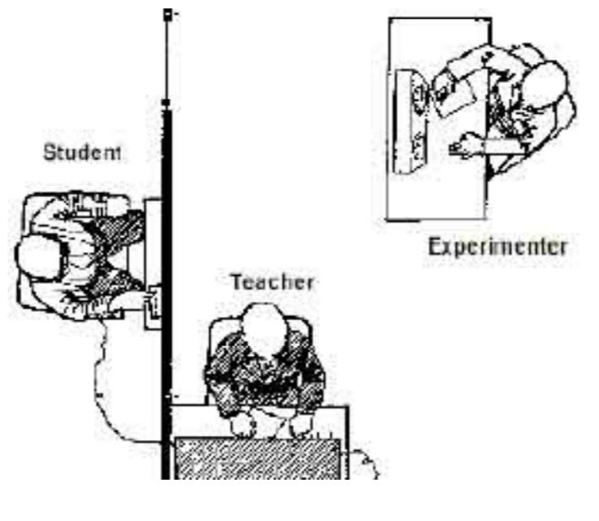
Conformity, Compliance, and Obedience
How do you think the information gained from the Milgram Experiment could relate to Nazi concentration camps?

Slide 12
Social Influence | Description
Conformity | Changing your behavior to go along with the group even if you do not agree with the group
Compliance | Going along with a request or demand
Normative social influence | Conformity to a group norm to fit in, feel good, and be accepted by the group
Informational social influence | Conformity to a group norm prompted by the belief that the group is competent and has the correct information
Obedience | Changing your behavior to please an authority figure or to avoid aversive consequences
Groupthink | Tendency to prioritize group cohesion over critical thinking that might lead to poor decision making; more likely to occur when there is perceived unanimity among the group
Group polarization | Strengthening of the original group attitude after discussing views within a group
Social loafing | Exertion of less effort by a person working in a group because individual performance cannot be evaluated separately from the group, thus causing performance decline on easy tasks
Deindividuation | Group situation in which a person may feel a sense of anonymity and a resulting reduction in accountability and sense of self

Slide 13
Item | Function | Connection | Example
Stereotype | Cognitive; thoughts about people | Overgeneralized beliefs about people may lead to prejudice. | “Yankees fans are arrogant and obnoxious.”
Prejudice | Affective; feelings about people, both positive and negative | Feelings may influence treatment of others, leading to discrimination. | “I hate Yankees fans; they make me angry.”
Discrimination | Behavior; positive or negative treatment of others | Holding stereotypes and harboring prejudice may lead to excluding, avoiding, and biased treatment of group members. | “I would never hire nor become friends with a person if I knew he or she were a Yankees fan.”

Slide 14
Types of Prejudice and Discrimination
Racism
Ageism
Sexism
Homophobia & Transphobia

Slide 15
How can discrimination exist?
Self-fulfilling prophecy
Confirmation bias
In-group vs out-groups
In-group bias
Scapegoating

Slide 16

Aggression
Hostile aggression vs instrumental aggression
Bullying and cyberbullying
Bystander effect
Diffusion of responsibility

Slide 17
Prosocial Behavior
Altruism
Empathy and sympathy
Homophily
Reciprocity
Self-disclosure

Slide 18
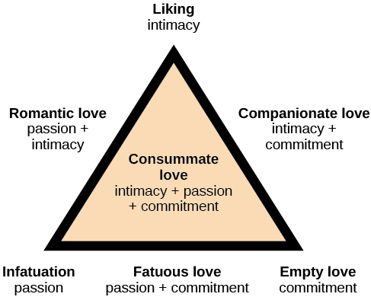
Sternberg’s Triangular Theory of Love
Provide an example for:
1. Romantic love
2. Companionate love
3. Fatuous love
4. Consummate love

Slide 19
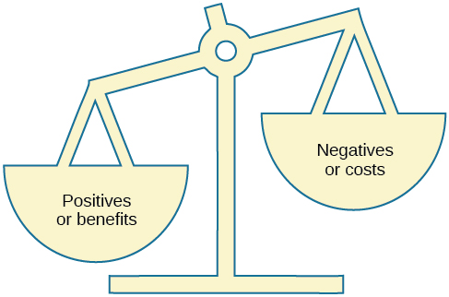
Social Exchange Theory

Slide 20
Next time on PSY 203…
BEFORE NEXT CLASS:
Read Chapter 13 & take quiz
Sign up for SONA studies
Study for Exam 3
NEXT CLASS:
Chapter 13- Industrial-Organizational Psychology

